Slide 1
Library Management System
Presented by Gabriel Agbo

Slide 2
What will Be Covered?
Objectives
System Requirements
Security Requirements
System Sequence Diagram
User interface
Project Cost

Slide 3
Objectives
The mission of this program is to provide speedy and wide access to updated information and save the time of its users or members.
Provide easy ways for librarians to create and store their library collections. It enables students and staff to communicate and collaborate through multiple channels.

Slide 4
System Requirements
Only authentic user with a valid member card must have the access to the system
User must be able to Search, Rent, and Return a book
User must enter issue and return date in database
Same user ID cannot rent more than 5 books
User must sign a “DO NOT COPY DISCLAIMER” consent before checking out

Slide 5
Security Requirements
System will use secured database
Normal users can only read information
System will have different types of users and every user has access constraints

Slide 6
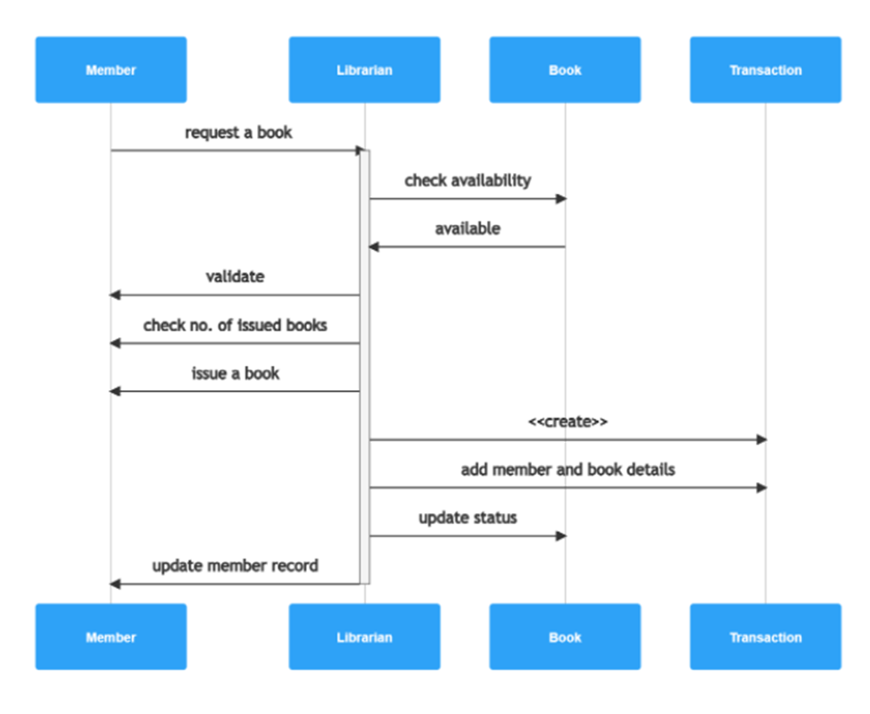
System Sequence Diagram

Slide 7
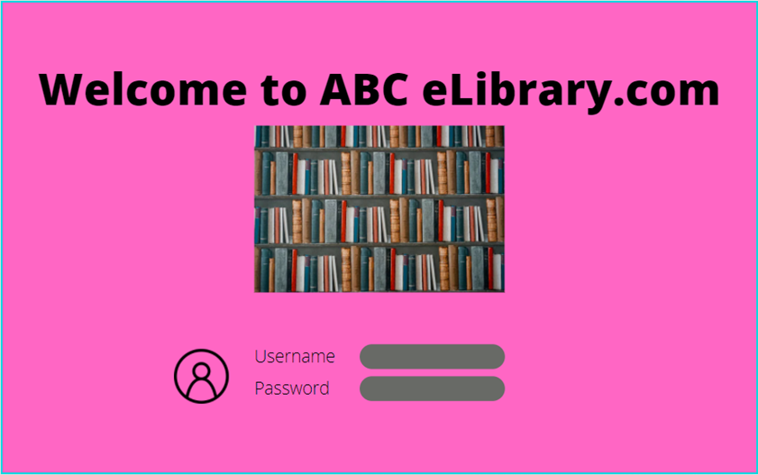
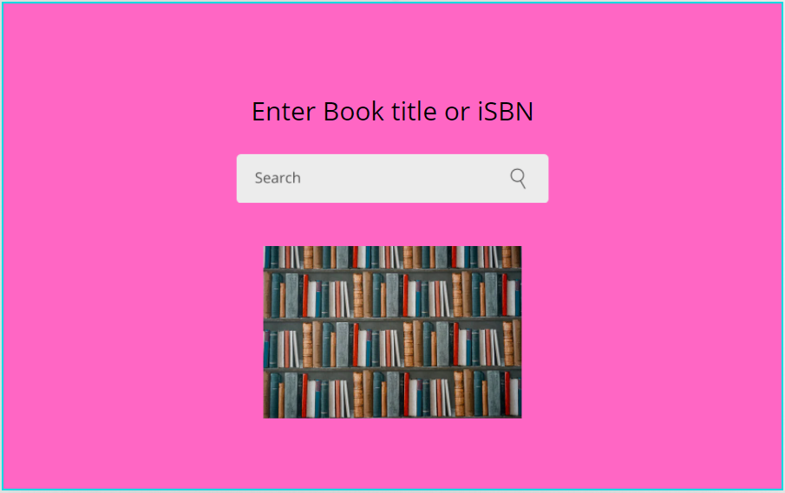
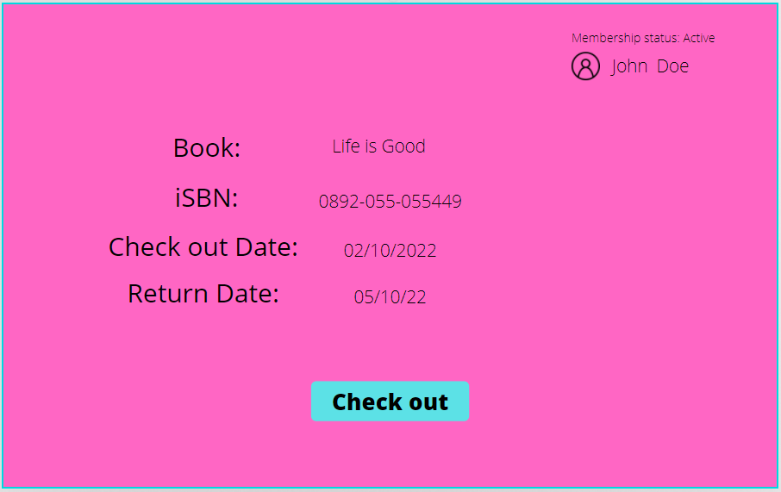
User Interface

Slide 8
Project Cost
Based on the project size and all the features, the cost range is estimated between $30,000 to $40,000.
Programmers $10,000 - $15,000
Equipment $10,000
Technicians $5,000 - $10,000
Training cost $5,000 - $7,000

